Slide 1
Unity Performance Optimisation
SDL Activity

Slide 2
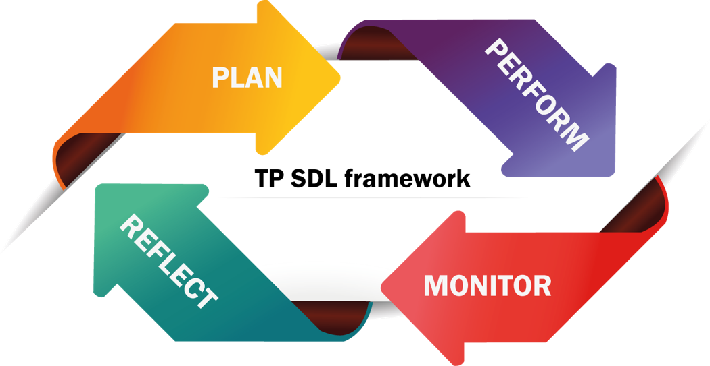

Slide 3

Developing Self-Directed Learning

Slide 4
Self-Directed Learning Assignment
This is a self-directed learning exercise
You will do your learning on Unity Performance Optimization and create a video on the topic allocated to you.
For more details refer to your brief on Practical Assignment - Presentation

Slide 5
Understanding optimization in Unity
Unity documentation
Profiling
Memory
Coroutines
Asset auditing
Strings and text
The resources folder
General optimizations
Special optimizations

